Slide 1
Intermediate Deep Learning with Tensorflow and Keras
GitHub (Slides and Code): https://github.com/niaid/bcbb-training-intro-to-deep-learning
September, 2021
Daniel Veltri, Ph.D. (Email: daniel.veltri@nih.gov)

Slide 2
For Today’s Training
Installation instructions are available on the course GitHub: https://github.com/niaid/bcbb-training-intro-to-deep-learning
I recommend you clone the repo to your local machine to have local copies of the scripts we will use.
Python Users: Activate the environment you installed in a terminal followed by the IDE of your choice:
conda activate tflow
R Users: Start Rstudio, open the example script files, and select the following from the top menu:
Session > Set Working Directory > To Source File Location

Slide 3
Some topics to continue your Tensorflow+Keras journey…

Slide 4


Keras Models Come in Three Flavors
Sequential Model: A linear model with a single track connecting one input to one output
Functional API: Allows arbitrary model design with multiple inputs/outputs and support for shared layers
Model Subclassing: User-coded model class for full control and complex situations

Slide 5
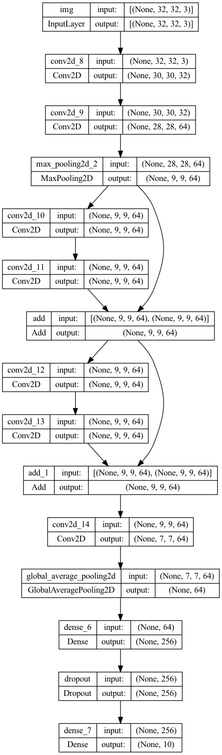
The Functional API
The Functional API in Keras allows arbitrary inputs and outputs, branches in the network and the ability to do “skip connections”
As the name implies - we can also call Functional models as a function! This makes it easy for reuse or building ensembles (build different models on the same data and average)
Where we used to start with the Sequential function call, we now define one or more ”input_layers.” We can reuse these multiple times
We also need to define our output(s) – if we we have multiple inputs that need to merge into a single output, we need to use “merging layers” to glue them together
Typically the real “work” of a model is saved into a separate variable (say ”x”) so that the inputs and output layers can be easily modified or reused
Skip
Connection!
Skip
Connection!
Model plot image: https://keras.io/guides/functional_api/

Slide 6
Refactoring for Function
Lets take a look at our ”hello world” example refactored to use the Functional API
We’ll then practice redoing our CNN code example using the Functional API as well

Slide 7
Merging Layers
When two branches meet, we need to use a “merging layer” to combine them into one output.
This is done using one of the following operations on the tensor outputs of each branch: concatenate, average, maximum, minimum, add, subtract, multiply, or dot (product)

Slide 8
Callbacks API
Callbacks allow you to perform an action at the start or end of an epoch
Examples: Write TensorBoard logs, save model checkpoints, terminate training when improvement stops, adjust learning rates, view internal states
Custom callbacks can also be programmed if desired

Slide 9
Callbacks API
Callbacks are defined as a list, and passed to the callbacks parameter in model.fit(), model.evaluate(), or model.predict()
my_callbacks = [ tf.keras.callbacks.EarlyStopping(patience=3),
tf.keras.callbacks.ModelCheckpoint(filepath='model.{epoch:02d}-{val_loss:.2f}.h5’),
tf.keras.callbacks.TensorBoard(log_dir='./logs’) ]
model.fit(x, y, epochs=10, callbacks=my_callbacks, … )
my_callbacks = list( callback_early_stopping(patience=3),
callback_model_checkpoint(filepath='model.{epoch:02d}-{val_loss:.2f}.h5’),
callback_tensorboard(log_dir=‘./logs’) )
model %>% fit(x, y, epochs=10, callbacks=mycallbacks, … )
Python
R
I recommend checking the Keras reference APIs for callback-specific parameter options

Slide 10
Exercise
Add the following two callbacks to your ‘hello world’ script:
Stop training after it doesn’t improve within 5 epochs
Save a checkpoint file during training – set the “save_best_only” parameter to true so you only save the best model

Slide 15
Resources to Continue Learning
Books:
Deep Learning with R by Francois Chollet and J. J. Allaire (2nd Edition 2022)
Deep Learning in Python by Francois Chollet (2nd Edition 2021)
Neural Networks and Deep Learning (Free ebook: http://neuralnetworksanddeeplearning.com)
Blogs:
Deep Learning Blog: http://deeplearning.net/blog/ (Lots of conference announcements)
Google’s Deep Mind Blog: https://deepmind.com/blog/ (lots of research papers published)
Jason Brownlee’s Site: https://machinelearningmastery.com (lots of great code examples)
Online Competitions
Kaggle – You can see lots of Deep Learning (and other ML) approaches to a wide array of data sets: https://www.kaggle.com
arXiv – This seems to be the place where many of the industry greats first publish
Check out publications by Yann LeCun, Yoshua Bengio, Geoffrey Hinton for some classic papers
Papers on “Adversarial Networks” are currently a hot topic

Slide 16
Questions???

Slide 17
Bonus Topic: How do we visualize results?
Notes:
This section can be skipped if low on time

Slide 18
What is dimensionality reduction (DR) again?
The idea is we want to take “high dimensional” data (let us just assume this is R^{d} with d >> 3 … data that is hard to plot) and embed it in a lower dimensional space
Embedding function
Crazy high-dimensional manifold / space
< 1, 2, 3, …, N >
Nice dimensions for plotting data
< 1, 2 >

Slide 19
So what’s wrong with good old PCA?
Answer: Nothing! For many data sets it continues to work very well… probably still worth trying it first when you get new data
PCA Benefits: Established track record, allows conversion between original and PCA projections, fast, many great software libraries available for it
Drawbacks: It is a linear method with an objective to maximize variance by preserving the largest pairwise distances… can create ugly pictures for complex data

Slide 20
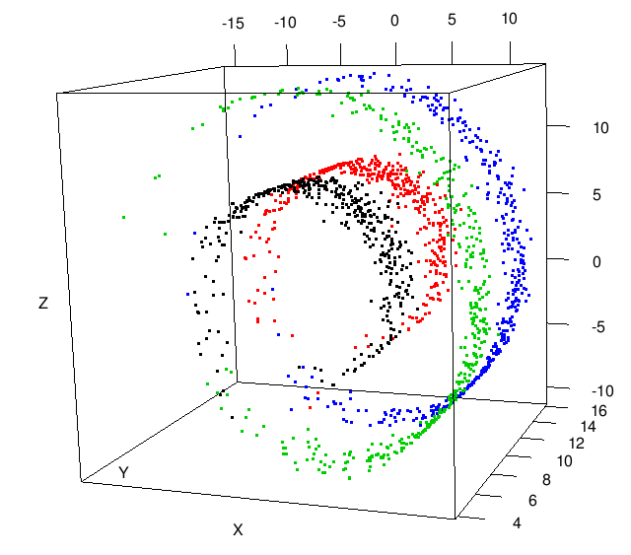
Where PCA has some trouble...
You can try this yourself! Sample swiss roll data at:
http://people.cs.uchicago.edu/~dinoj/manifold/swissroll.html

Slide 21
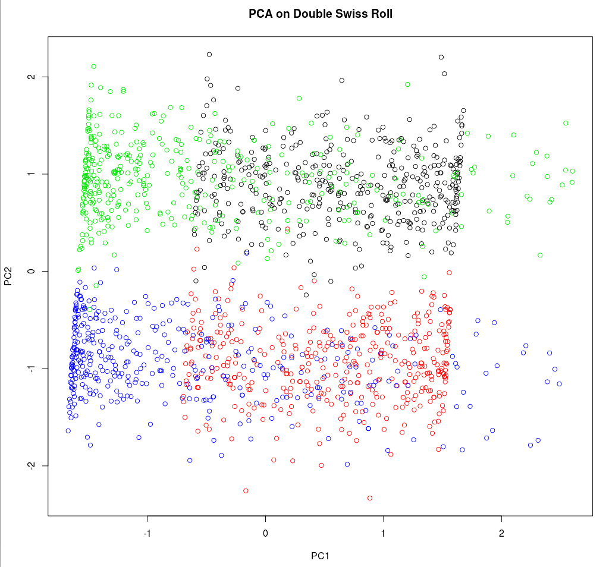
Where PCA has some trouble...

Slide 22
t-Distributed Stochastic Neighbor Embedding (t-SNE)
A nonlinear embedding method that can capture local patterns in complex non-uniform data (the “crowding problem”)
Introduced in 2008 by Laurens van der Maaten (Formerly Delft Univ., now Facebook AI) and Geoffrey Hinton (Univ. Toronto and Google)
Original Paper: van der Maaten and Hinton (2008) Journal of Machine Learning Research 9:2579-2605.
Winner of the Merck Visualization Challenge Kaggle Competition
Library Implementations: R, Python, Matlab, Java, CUDA, Torch, Javascript, etc.
Code available at: https://lvdmaaten.github.io/tsne/
Notes:
Recent bio examples using t-sne:
Shekhar et al – differentiate between cellular phenotypes related to the immune system using mass cytometry
Ji et all used it to analyze relationships between gene expression and neuroanatomy in mouse brains
Fonville showed it outperformed PCA to model mass spec imaging data

Slide 23
Basic concept of t-SNE
First, identify local neighborhoods in the original space (think k-nearest neighbors) by building a probability distribution using a t-Student Gaussian to represent the pairwise distances of points
The distribution identifies points that have a higher probability of being close to each other in the original space. Tails of t-Student distribution help where groups of data points have variable density
To map to our new space, minimize the Kullback-Leibler (KL) divergence of the original and new embedded point distributions
Mapping is stochastic, so the algorithm may produce different figures each run, but the KL divergence should be consistent.
Unlike PCA, t-SNE does not have a clear way to map new data to the embedding space- van der Maaten recommends training a multivariate regressor to map new points.
Min(KL Divergence)
Notes:
KL measures how one probability distribution diverges from a second expected probability distribution. Divergence of of 0 indicates = near identical dist. While 1 indicates fundamentally diff. distributions.

Slide 24
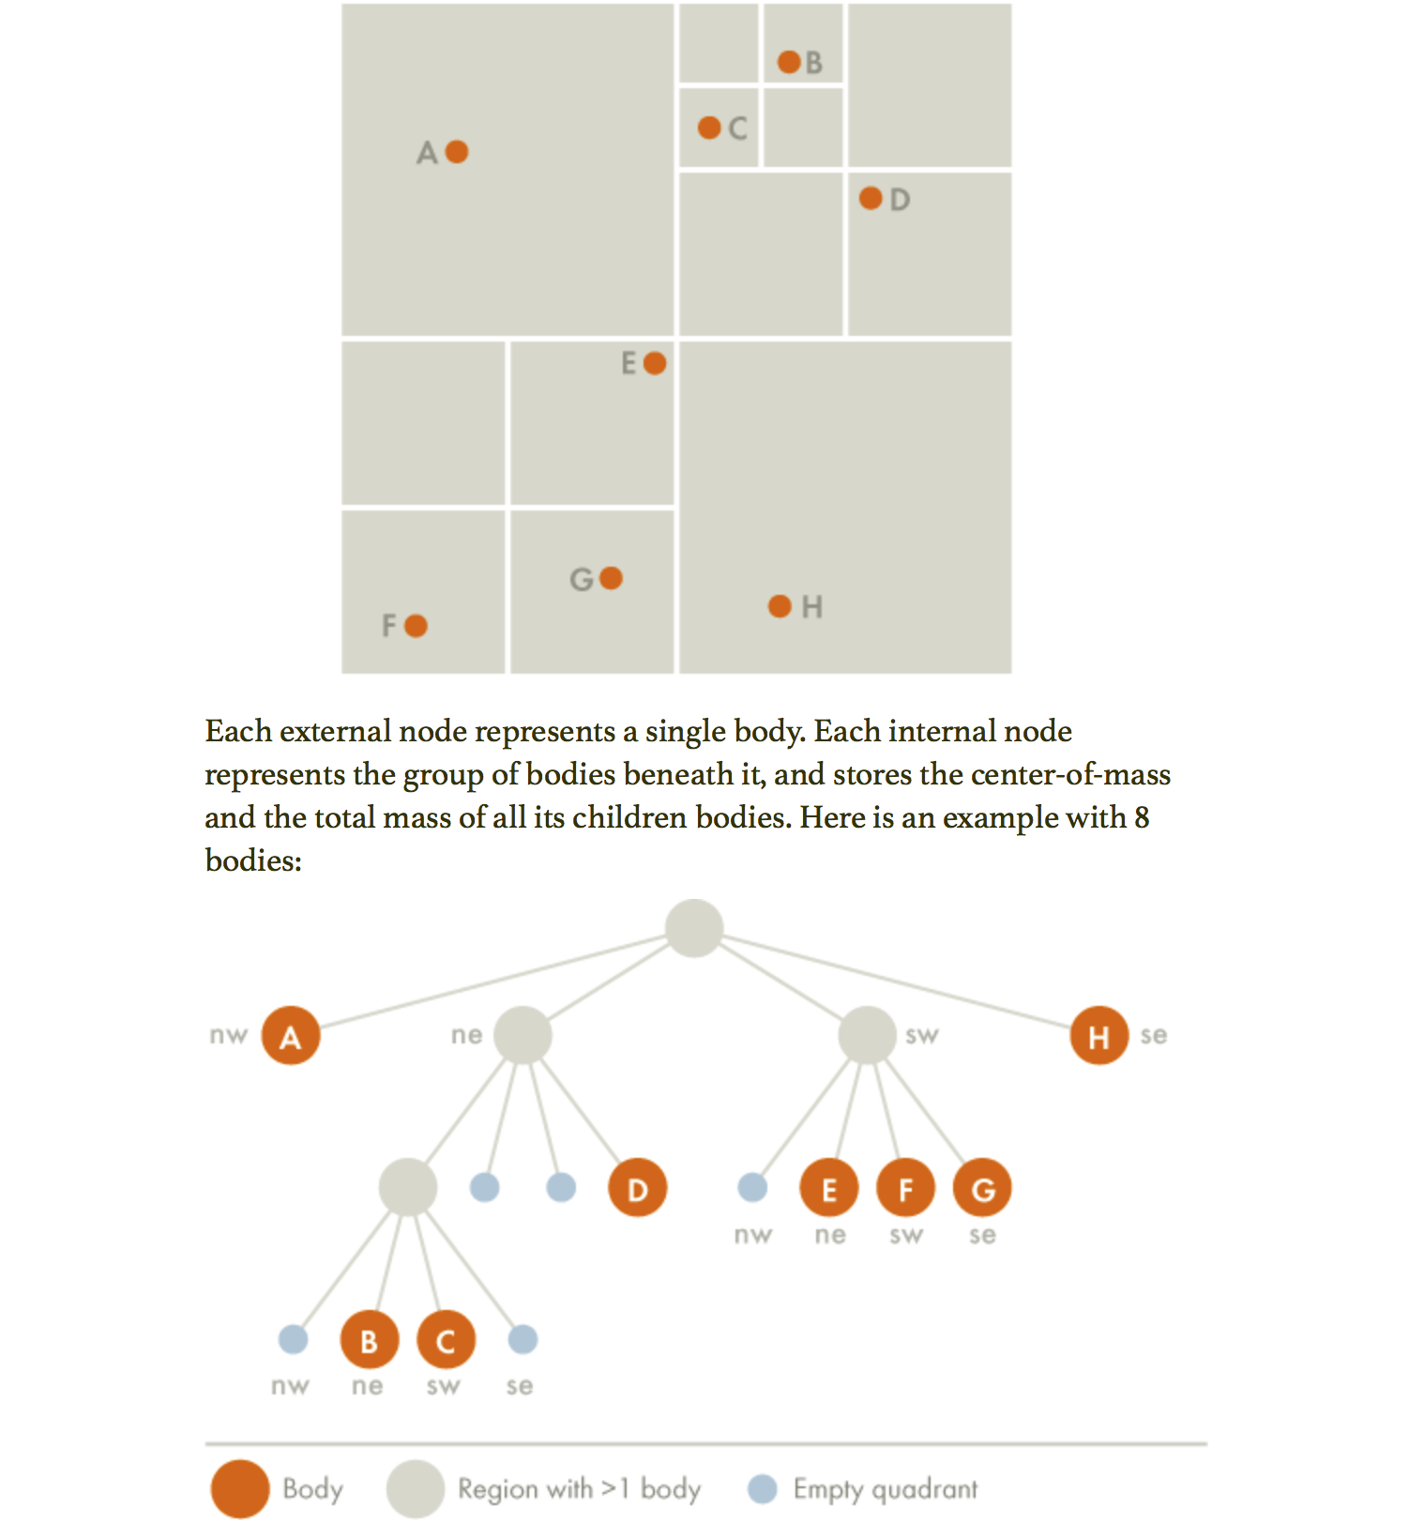
Barnes-Hut approximation (BH-SNE)
t-SNE is rather slow O(N²) and limited to smaller data sets (a few thousand points)
Van der Maaten found a way to greatly speed up the algorithm using the “Barnes-Hut” transformation based on quad trees to get runtime down to O(N log N)
Using this implementation we can handle tens of thousands of points, perhaps hundreds of thousands, but the algorithm is still limited depending on your concept of “big data”
BH Implementation Paper: LJP van der Maaten (2014) Journal of Machine Learning Research 15(Oct):3221-3245.

Slide 25
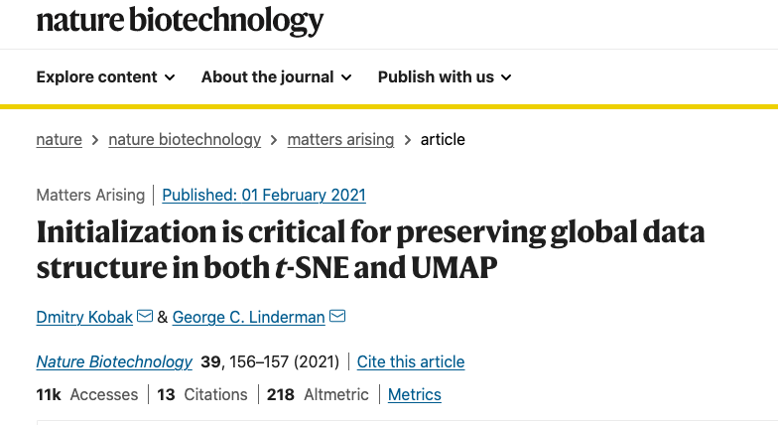
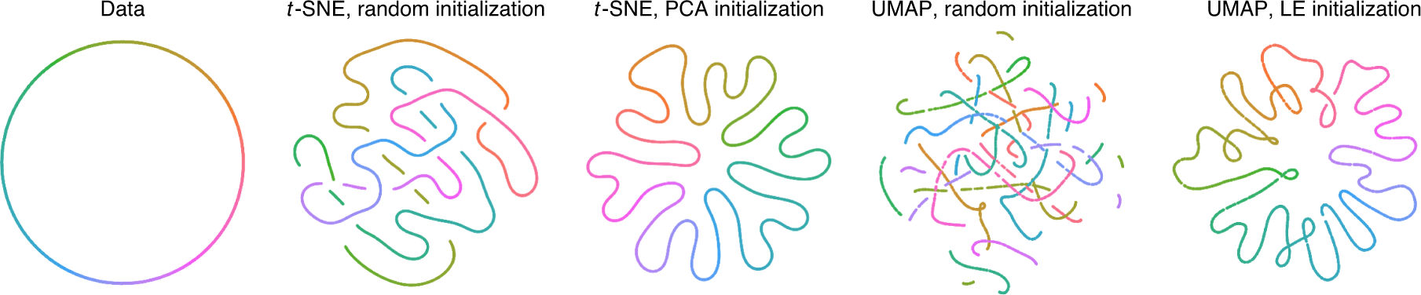
How you initialize values is important!
Important read:

Slide 26
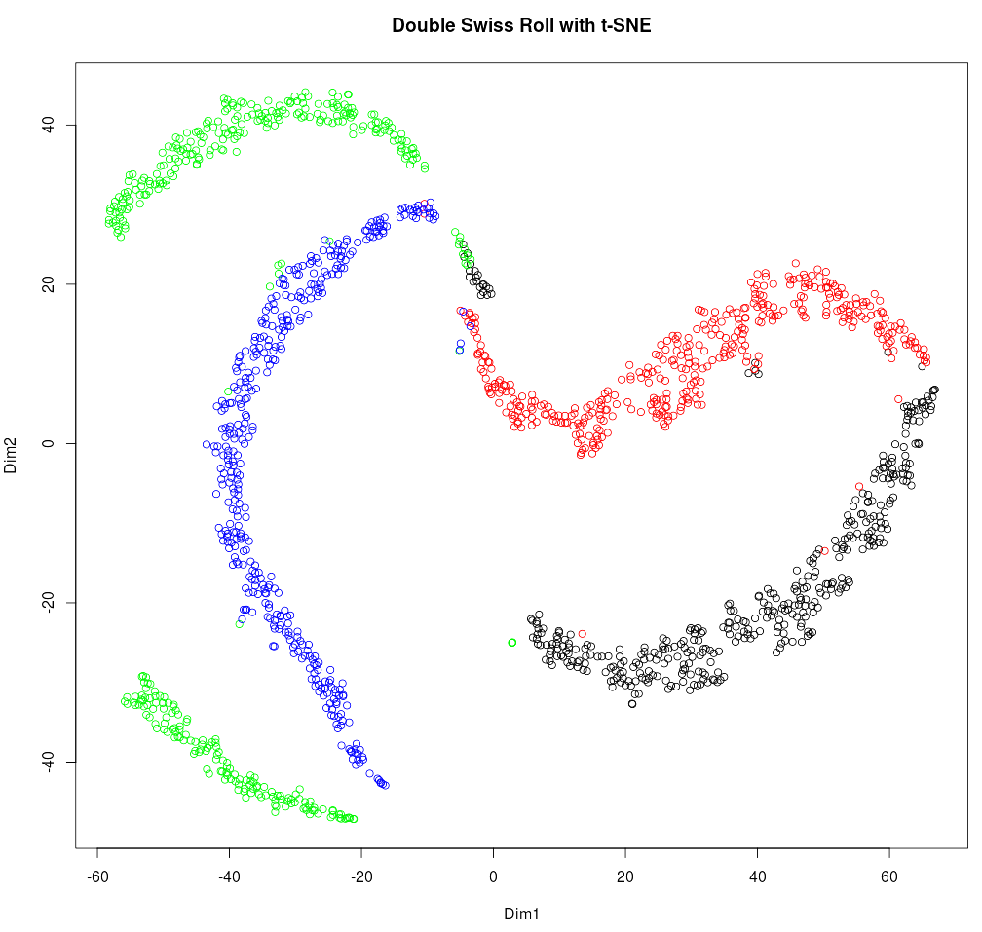
t-SNE on the double swiss roll…
Notes:
Set perplexity between 5-50
Theta is the Barnes Hut tuning parameter, 0=Oirignal algorithm

Slide 27
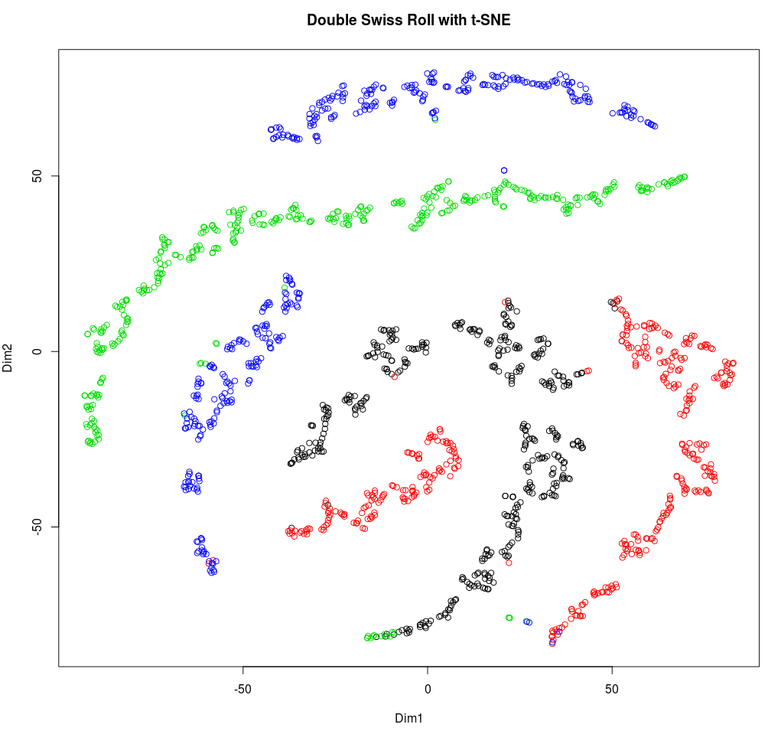
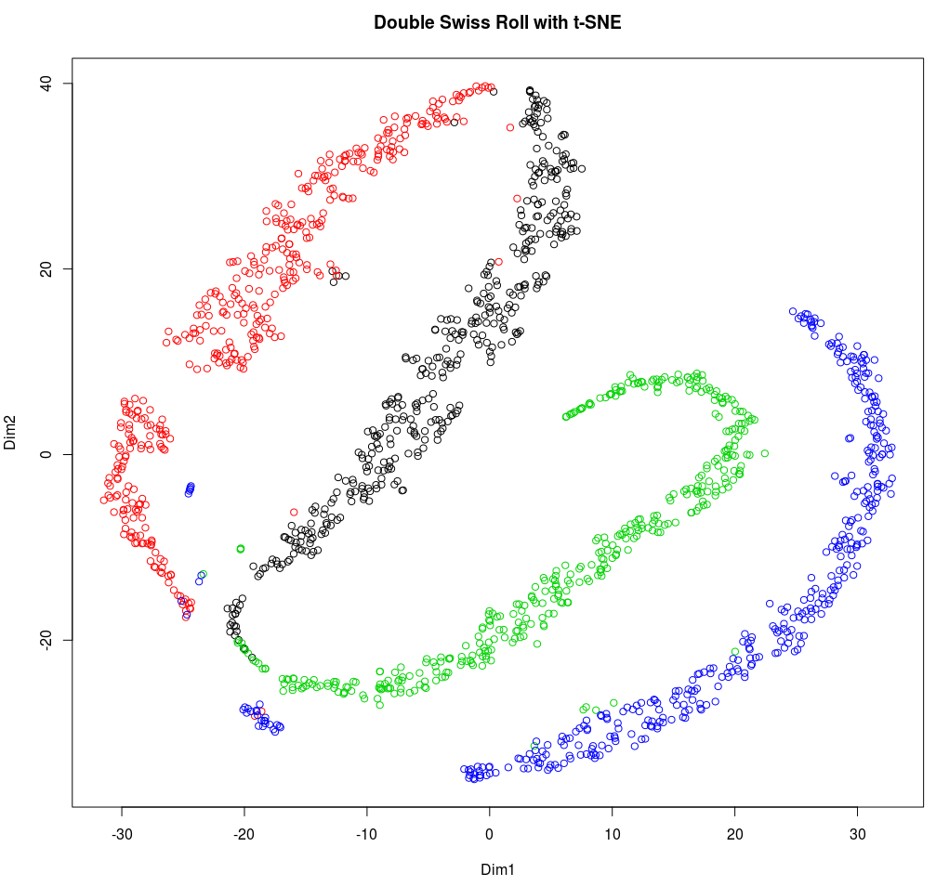
Trying some different parameters…
Theta = 0 (original t-SNE)
Perplexity = 10
Theta = 0 (original t-SNE)
Perplexity = 30 (default)
Theta = 0.5 (BH default)
Perplexity = 30 (default)
Notes:
Perplexity is scaling the bandwidth of the Gaussian (sigma)

Slide 28
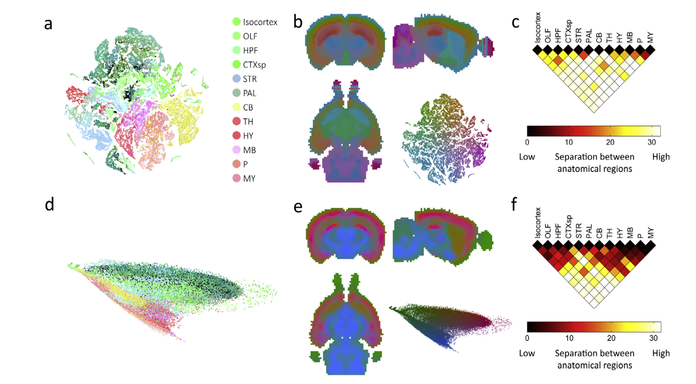
A look at some biological data from Mahfouz et al. 2015
Mouse Transcriptome Expression Mouse Atlas Mapping Divergence Plots
Mahfouz et al. compared linear and non-linear embedding methods to visualize brain transcriptome data
They first considered data from the ALLEN Mouse Brain Atlas (~20K genes profiled)
They also collected new data from 6 human brains and mapped to the ALLEN Human Brain Atlas (~29K genes profiled)
BH-SNE
PCA (PCs 1+2)
Mahfouz et al. (2015) Methods 73:79-89
Notes:
Fig. 1. Coronal mouse brain transcriptome similarities. (a) BH-SNE map of the mouse coronal data initialized with 10 principal components and colored by anatomical region labels from the Allen Reference Atlas: cortex (Isocortex), olfactory areas (OLF), hippocampal formation (HPF), cortical subplate (CTXsp), striatum (STR), palladium (PAL), cerebellum (CB), thalamus (TH), hypothalamus (HY), midbrain (MB), pons (P), and medulla (MY). (b) The mouse coronal data mapped back to the 3D volume of the mouse atlas (3 views) and colored by the L⁄a⁄b⁄ colormap of the BH-SNE mapping at a constant L⁄ value. (c) Divergence plot for BH-SNE showing the similarity between pairs of neuroanatomical regions. A higher divergence value (lighter colors) indicates better separation between a pair of neuroanatomical regions in the 2D BH-SNE map. (d) The first two PCA components of the mouse coronal data colored by anatomical region labels from the Allen Reference Atlas. (e) The mouse coronal data mapped back to the 3D volume of the mouse atlas (3 views) and colored by the L⁄a⁄b⁄ colormap of the PCA mapping. (f) Divergence plot for PCA showing the similarity between pairs of neuroanatomical regions. A higher divergence value (lighter colors) indicates better separation between a pair of neuroanatomical regions in the 2D PCA map.

Slide 29
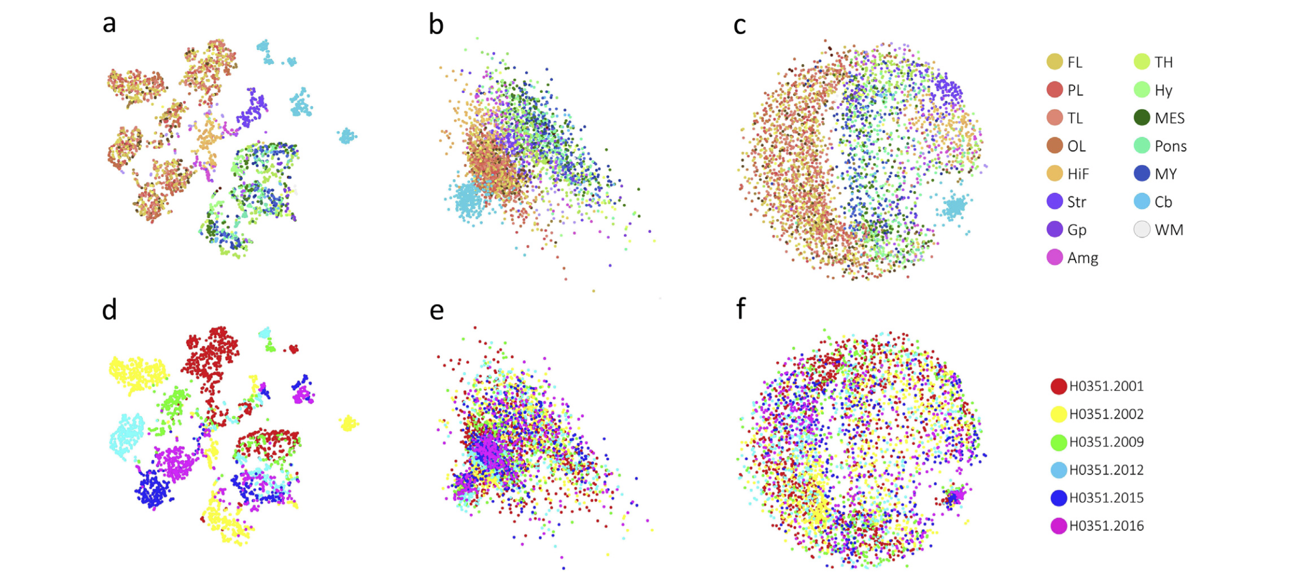
Embeddings for the human brain data
BH-SNE PCA Multidimensional Scaling
Allen Ref. Atlas Brain Region
Aggregated gene
expression levels colored by region:
Re-colored by brain donor:
Donar
Mahfouz et al. (2015) Methods 73:79-89
Notes:
BH-SNE reveals local and global structure of the spatial transcriptome of the brain.
•BH-SNE maps are highly consistent between mouse and between human datasets.
•BH-SNE is superior to PCA and cMDS in separating anatomical regions in 2D embeddings.
•Anatomical separation of gene expression is quantified by Jensen–Shannon divergences.
•BH-SNE retains and detects non-anatomical inter-slice and inter-donor differences.

Slide 30
Running t-SNE in Code:
t-SNE in R
library(tsne)
X <- matrix(c(0,0,1,1,0,1,0,1,0,1,1,1),nrow=4,ncol=3)
dim(X) => [4,4]
X_2d <- tsne(X, k=2)
dim(X) => [4, 2]
# Get model layer weights for input
weights <- get_layer(model, layer_name)$output
t-SNE in Python
import numpy as np
from sklearn.manifold import TSNE
X = np.array([[0,0,0],[0,1,1],[1,0,1],[1,1,1]])
X.shape => (4,4)
X_2d=TSNE(n_components=2).fit_transform(X)
X_2d.shape => (4,2)
# Get model layer weights for input
weights = model.layers[0].get_weights()[0]

Slide 31
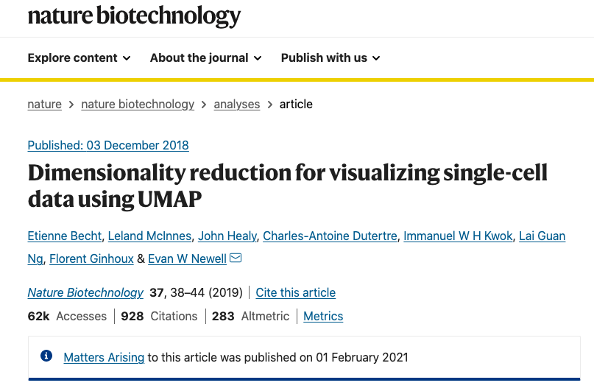
Some newer DR methods to check out…
Uniform Manifold Approximation (UMAP)
Initialization is also important here like with t-SNE!

Slide 32
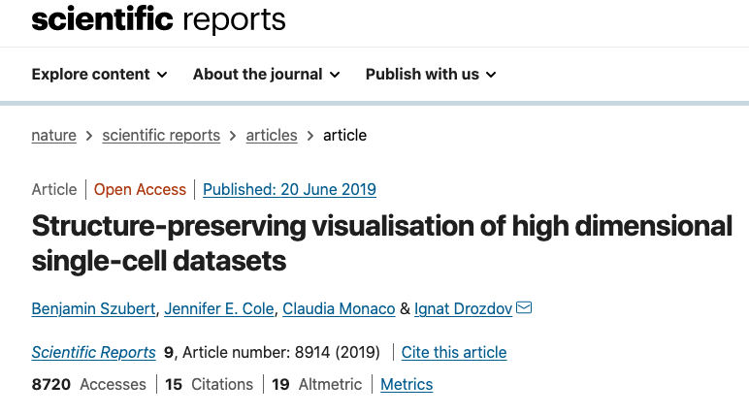
Some newer DR methods to check out…
Ivis algorithm
Comparing ivis to UMAP: https://dpfoose.github.io/posts/2019/10/29/Ivis_vs_UMAP.html

